Slide 1
Gold Price Prediction
Team Details:
Navya(2110993819)
Shreya Mittal(2110993836)
Deepanshi(2110993873)
Faculty Coordinator:
Dr. Shruti Arora
Chitkara University Institute of Engineering and Technology,
Chitkara University, Punjab

Slide 2
Table of Contents
Introduction
Problem Statement
Dataset Features
Data Preprocessing
Technical Details
Flowchart
Algorithm Used
Project Highlights
Conclusion
References/Links used

Slide 3
Introduction
The field of machine learning has become increasingly valuable in financial markets, where accurate predictions can greatly assist investors, financial institutions, and individuals in making informed decisions.
This model presents a machine learning project that focuses on developing a gold price predictor using the Random Forest Regressor algorithm.
The objective of this project is to build a robust model that can forecast the price of gold, allowing stakeholders to anticipate market trends and optimize their investment strategies.ms.

Slide 4
Problem Statement
The project aims to address the challenge of predicting the price of gold accurately.
Traditional forecasting methods often struggle to capture the non-linear and dynamic nature of gold price movements.
Therefore, applying machine learning algorithms, such as Random Forest Regressor, provides a promising approach to tackle this problem effectively.

Slide 5
Dataset Features
There are total 5 features in our dataset.
Date: Date in the dataset is telling us about the year and the month which describes the value at the time.
SPX: Capitalization index of top 500 companies
GLD: GLD here determines the gold price which is the feature predicted.
SLV: SLV here determines the silver price.
EUR/USD: Currency Medium

Slide 6
Data Preprocessing
Data Preprocessing :
Before training the machine learning model, the dataset underwent several preprocessing steps:
Handling missing values: Missing values were either imputed or removed based on the nature and quantity of missing data.
Feature encoding: Categorical features were encoded using techniques like one-hot encoding or label encoding to convert them into numerical representations.
Feature scaling: Numerical features were scaled to ensure all features had a similar range, typically using techniques like standardization or normalization.

Slide 7
Technical Details
Importing Python Libraries- We need to import important python libraries like numpy, pandas, matplotlib, seaborn etc. to train our model.
Data collection- The dataset collected for Gold Price Prediction is foretold into Training set and testing set
Data cleaning and preprocessing- The collected data may contain missing values that may lead to inconsistency. To gain better results data need to be preprocessed and so it'll better the effectiveness of the algorithm.
Model selection- We have a lots of Machine Learning Model from sklearn package, and we need to decide which model is give us the better performance.
Validation Process- We applied the hold-out validation process by holding 80% data on training and 20% data on testing.

Slide 8
Flowchart
Data Collection
Data Prepration
Data Splitting
Model Training
Model Selection
Feature Selection
Model Evaluation
Model Maintenance

Slide 9
Algorithm Used
Key Features in Model:
Random Forest Regressor: The Random Forest Regressor algorithm is chosen for this project due to its ability to handle both numerical and categorical features, handle non-linear relationships, and mitigate the risk of overfitting. The model is trained using historical data, and its hyperparameters are tuned to optimize its performance.
R-Squared: R-Square is a valuable metric for model evaluation as it provides a measure of how well the model fits the data and allows for the comparison of different models. However, it should be used in conjunction with other metrics to gain a more complete understanding of the model's performance.

Slide 10
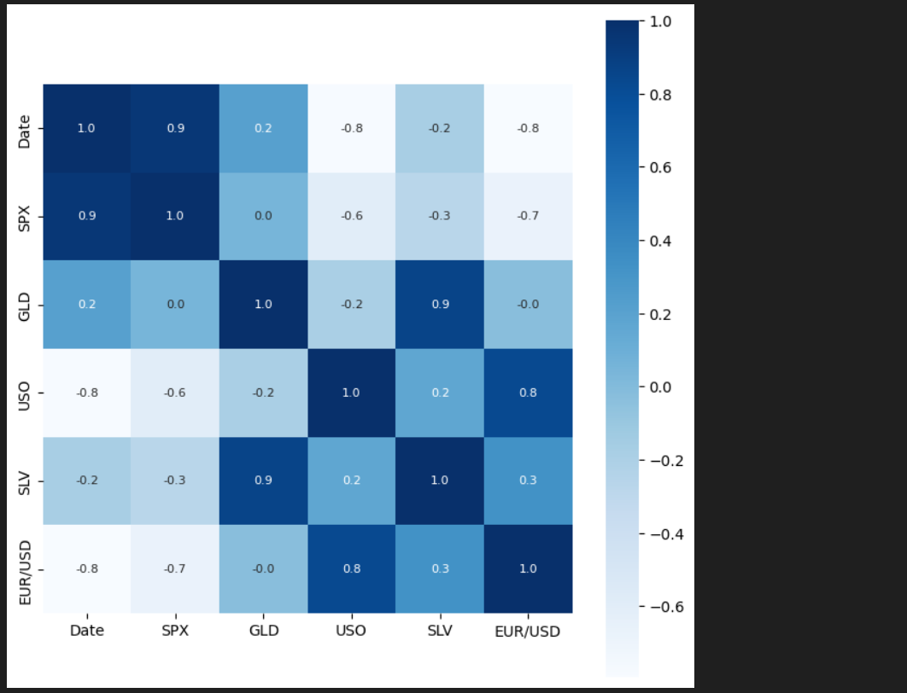
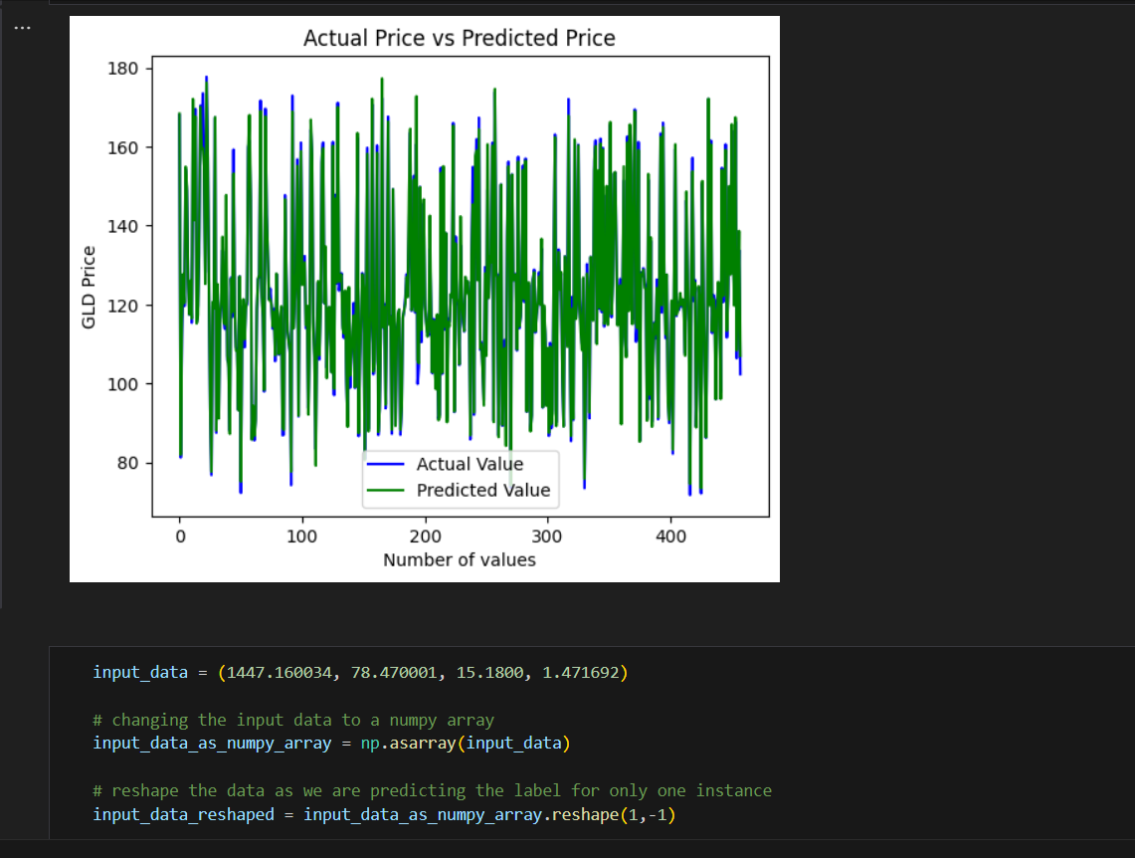
Project Highlights

Slide 11
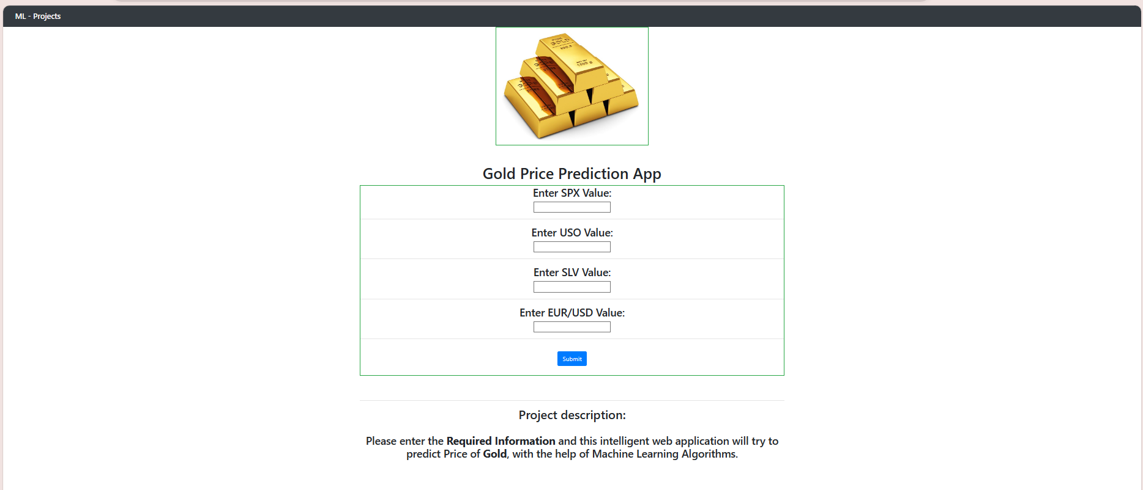
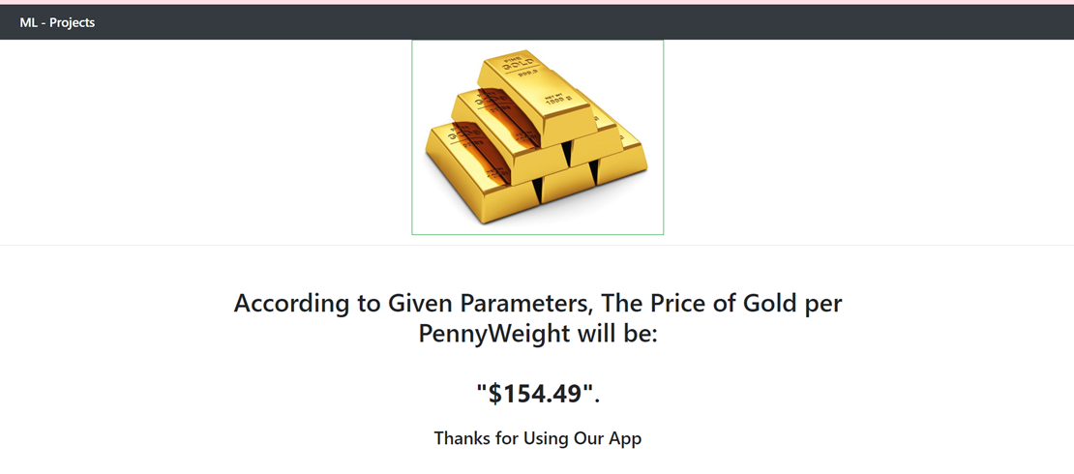

Slide 12
Conclusion
1)It is concluded that machine learning algorithms with Random Forest analysis are very useful in gold price prediction.
2)It is concluded that, the model's R-square is 97 percent. R-squared is usually 0 to 100 per cent. A score close to 100 per cent indicates that the Gold prices are well explained by the given model.

Slide 13
References/Links used
REFRENCES:
www.wikipedia.com
www.geeksforgeeks.com
www.github.com
www.kaggle.com

Slide 14


